Slide 1


Slide 2
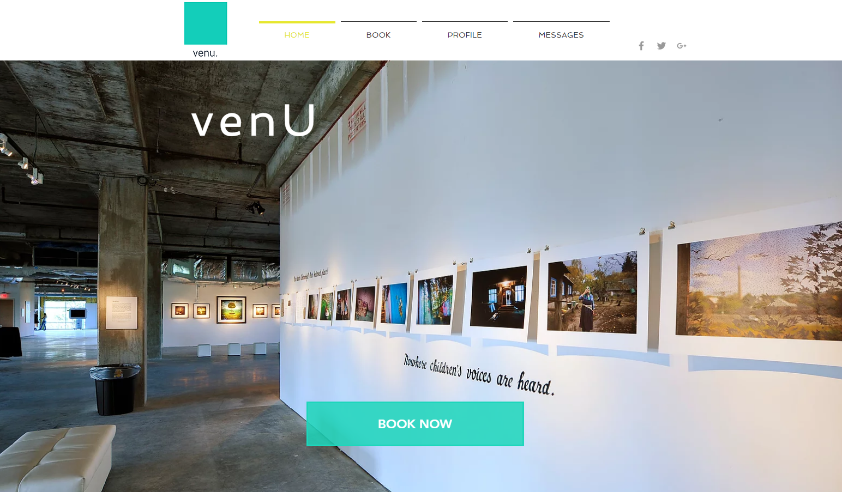

Slide 3
/ THE OVERVIEW
Venu is a web-based booking platform
created to serve as the most convenient way to book venues in any city.
Clients able to reserve & make payment w/ our platform
A useful way to promote local spaces and businesses
Community driven
Features: galleries, event spaces, and studio reservations with listed info on amenities and costs.
simple mobile & online booking.

Slide 4
/ Who would use it
Artists
Musicians
Curators
Business Owners
Non-profits
Organization
Artist Management
Tourists
The average consumer

Slide 5
/ Venu
Who would use it..
Suggested uses..
Demographics..
Features..
Pricing ..
Book!

Slide 6
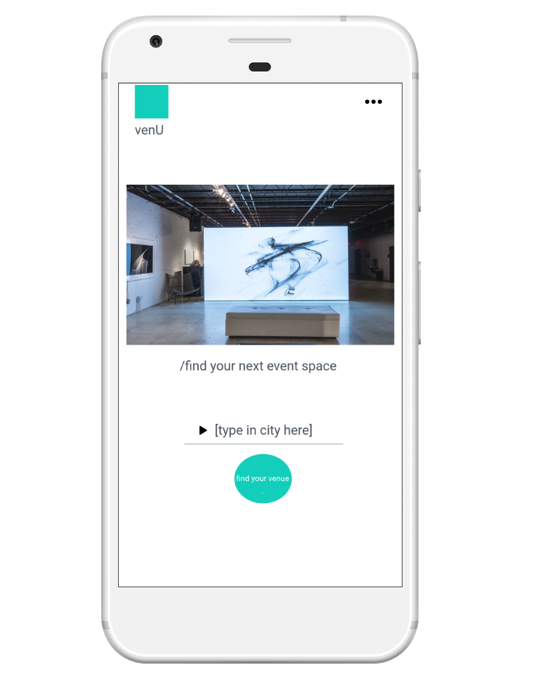
/ Suggested Uses
For:
Conferences
Parties
Performances
Shows
Tours
Private events
Promotion

Slide 7

/ Demographics
18 +
Inclusive and simplistic enough for all users.

Slide 8
/Features
Venue Profiles
Descriptions (images, amenities, cost, rates, restrictions, etc.)
Messenger
Chats are available for viewers that need questions answered as soon as possible.
Simple Booking
A few clicks from our next event

Slide 9
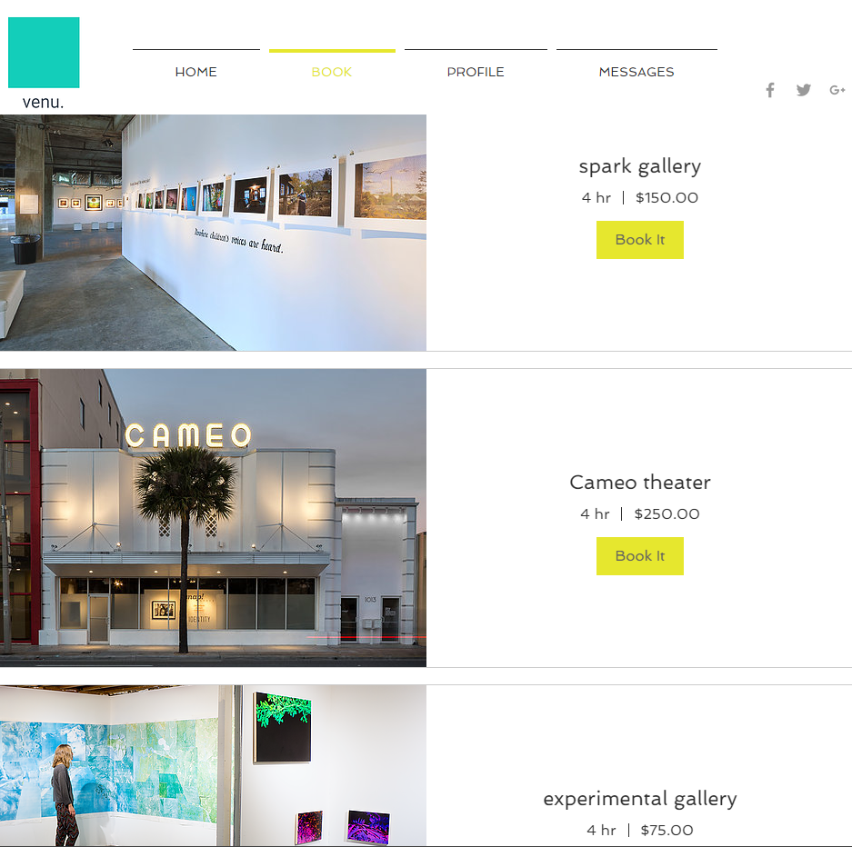
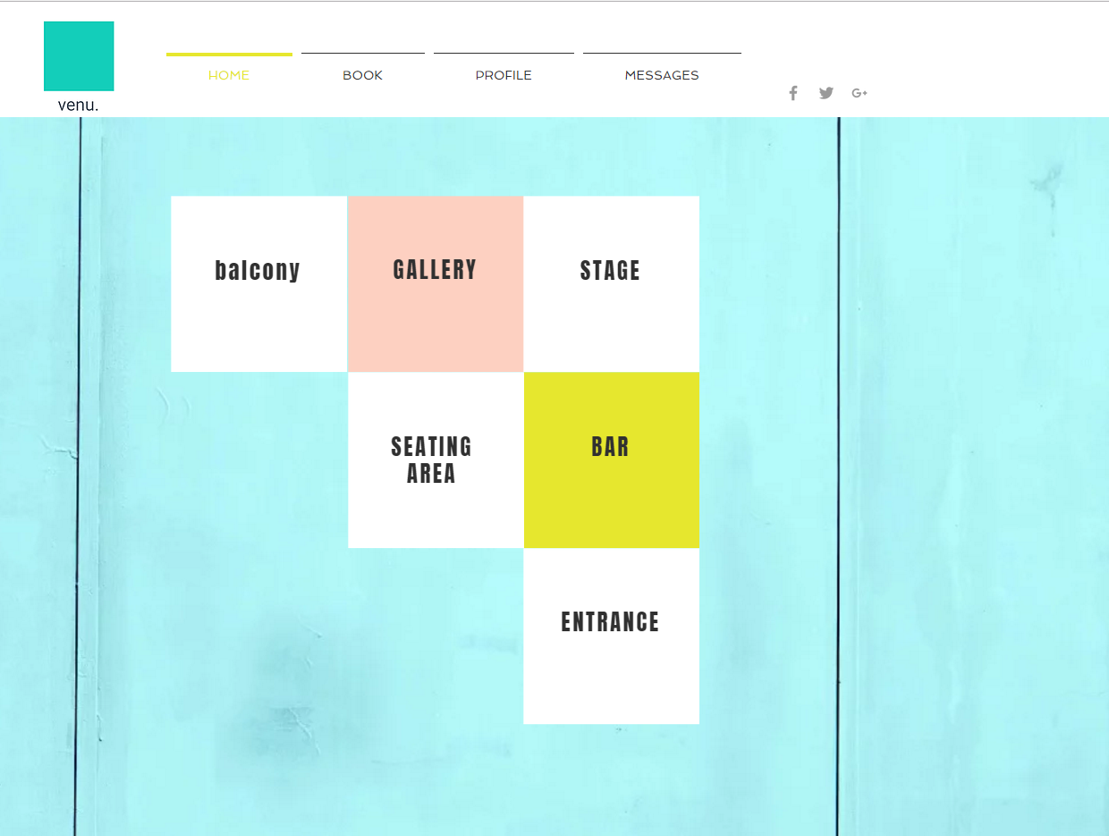
(Venue Profiles)
/features

Slide 10
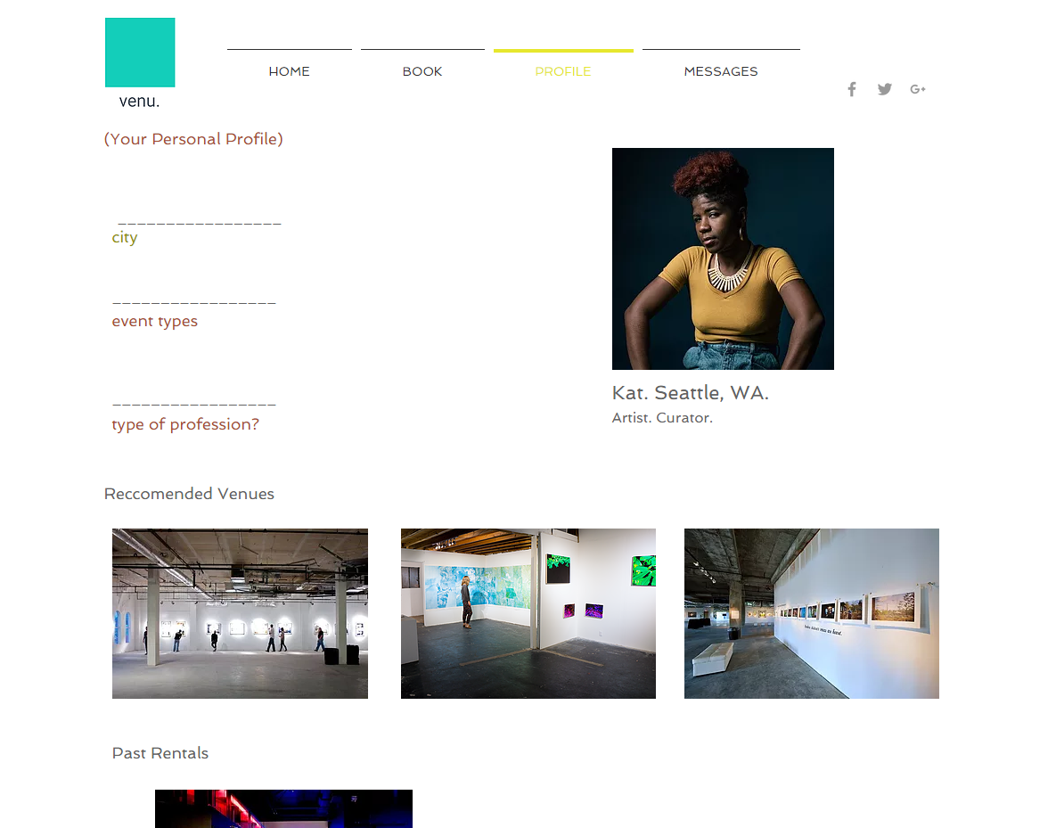
(renter Profiles)
/features
*making recommended venue suggestions based on
location, event type, size, etc.

Slide 11
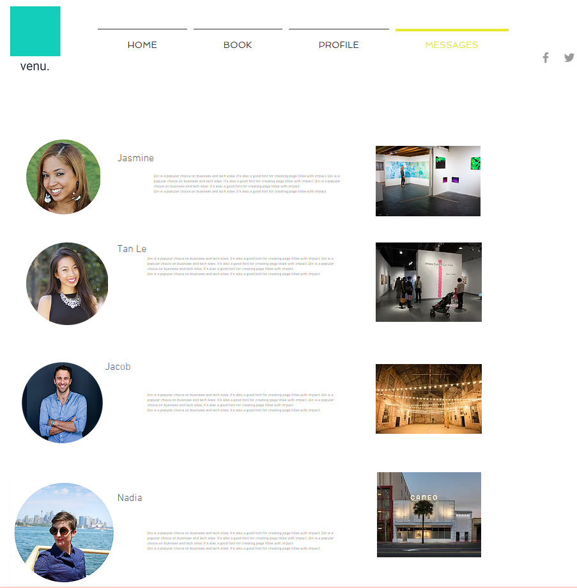
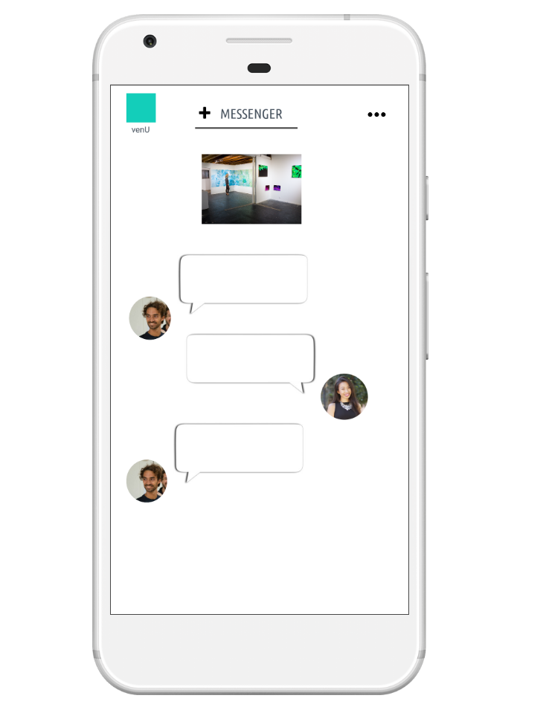
(MESSENGER)
/ features
/ Easy chat between customer
and property owner.
/ creates transparent customer
experience for both venue holders
and renters.

Slide 12



Conferences, exhibits...weddings, birthday parties...and yes. even hackathons +
/Find venues for

Slide 13
/Pricing
Affordable booking for everyone
Rate Caps
Service fee 5%
Inventors of the site 5%
Secure payments. (stripe)
Paypal & Venmo friendly

Slide 14
/Competitors
Venubook
Eventup
Skedda
Eventbooking
Eventbookingengines
Gather
ReServe Interactive
bookitlive
Event pro
Message blocks

Slide 15
/ Venu
What sets us apart?
Passionate about communal entrepreneurship.
Bring visibility to hidden creative venues & spaces.
Intentional about finding the best venues, at the most affordable rates.
Caters to local businesses, artists & local community. .

Slide 16
/ The Team
---- Mariah Roman
---- Amanda Wright
---- Jayla Mitchell
---- Juanita Griffith

